Slide 1
CSci 3081W: Program Design and Development
Lecture 01 - Introduction and Logistics

Slide 2
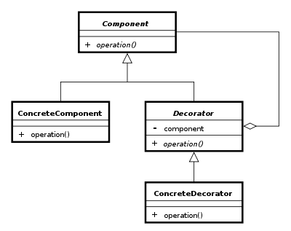
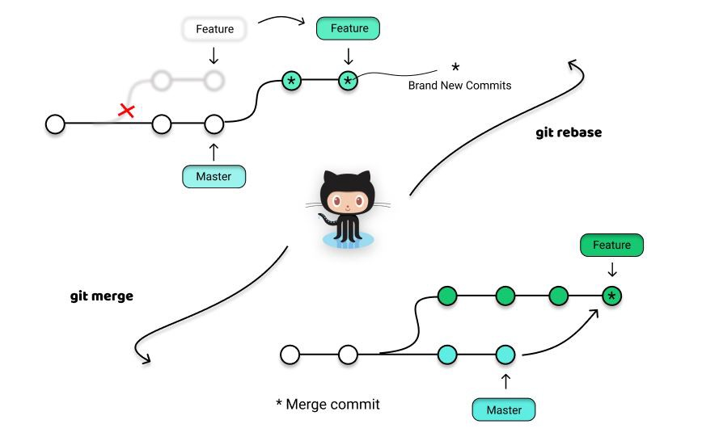

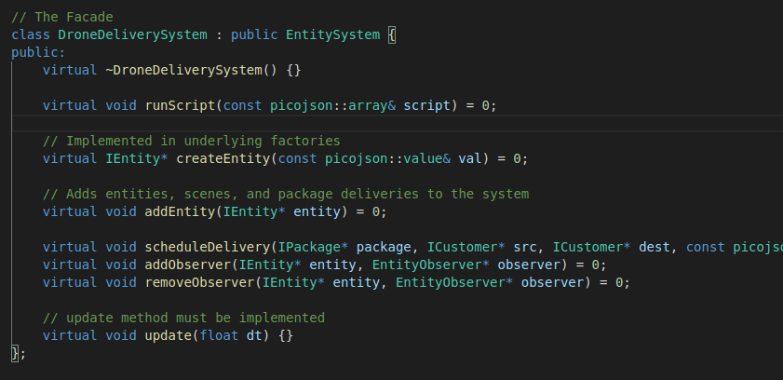
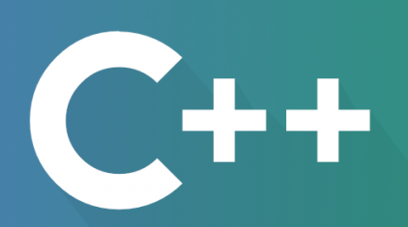
Welcome!
Program | Design | & Development
Course

Slide 3
CSCI 3081 Instructor Crew
Instructors
Teaching Assistants
Shonal Gangopadhyay
Zhengwen Jiang
John Johnson
Aaron Glick
Qinghong Fan
Yukang Cao Naome Etori
Nelson Trinh
Aaron Castle
Eren Erisgen
Ethan Jensen
Chi Vu
Zoe Johnson
Timothy Granatowski
Jonathan Clark-Harrer
Aurora Hall
Zoe Sepersky
Zoey Schmit
Trent Kelly
Israel Fuller
Srinivas Preetham Addepalli
Brandon Cheng
Email: gango010@umn.edu

Slide 4

Our course is about building a “BIG” project.
Drone Delivery System (e.g. Amazon Package Delivery)

Slide 5
Task - Project Planning: How would you build this system?
Drone Delivery System (e.g. Amazon Package Delivery)
In class exercise - no submission

Slide 6
This is a “practical” Design Class.
 | Design | Development
How can we best design a flexible system?
How can we best build a flexible system?

Slide 7
This is a “practical” Design Class.
 | Design | Development
6 Weeks
8 Weeks
How can we best design a flexible system?
How can we best build a flexible system?

Slide 8


This is a writing class: 3081W
 | Design | Development
How can we best design a flexible system?
How can we best build a flexible system?

Slide 9


Design Goals: How can we build a system that is flexible and fast?
Flexibility
Efficiency
VS
Code Reuse
Design Patterns
Extensibility
Fast Execution
Memory Efficient

Slide 10

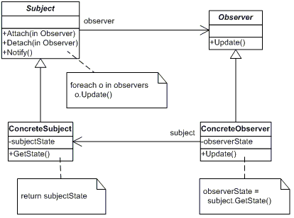
For example: We will learn Object Oriented Design

Slide 11




Development Goals: How do we build such a system?
Collaboration
Process
Automation
Robustness

Slide 12

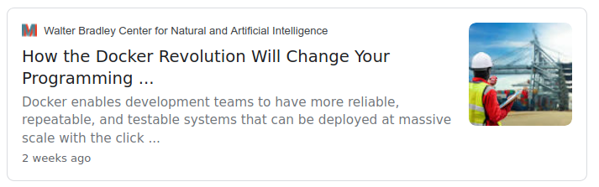
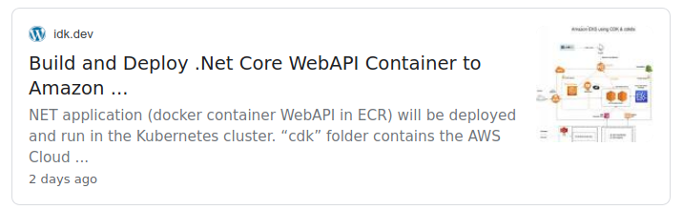
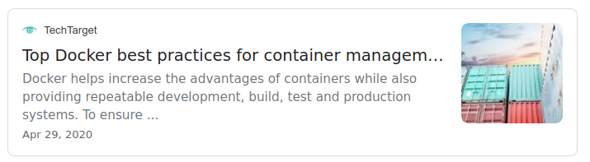
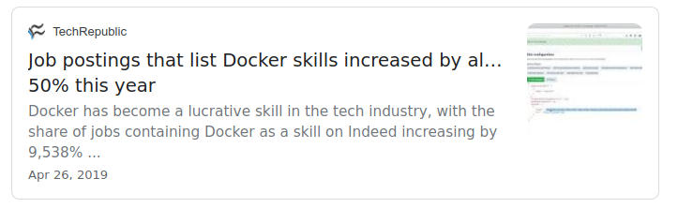
For example: We will learn and use Container Architectures.

Slide 13
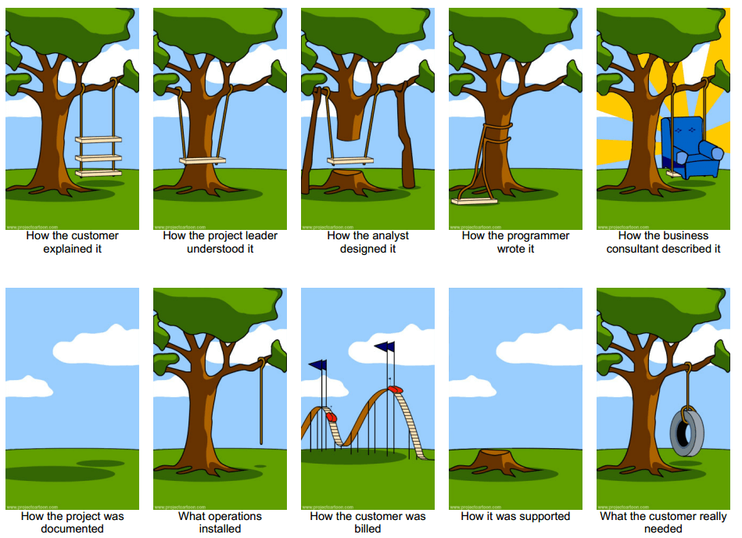
We will introduce some software engineering topics.

Slide 14
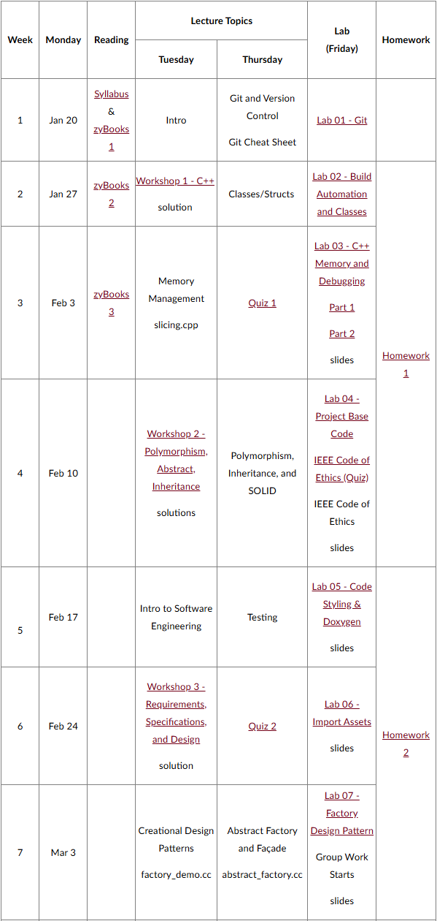
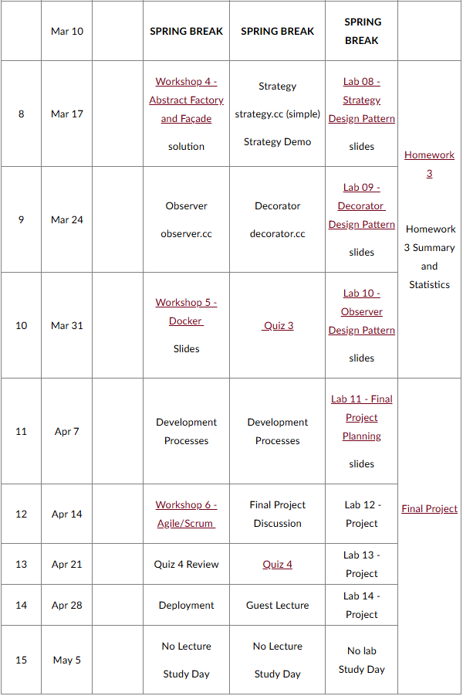
Course Details

Slide 15
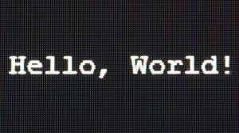


Roadmap for Today
Introduction
Course Logistics
Project Discussion

Slide 16
Please read the Syllabus carefully.

Slide 17
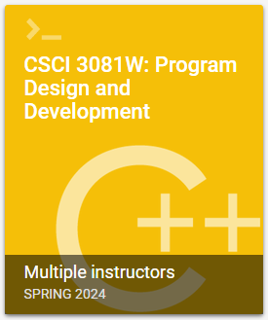

Textbooks
Click any zyBooks assignment link in Canvas. (Do not go to the zyBooks website and create a new account). Subscribe.
Head First Design Patterns (available through the UMN libraryLinks to an external site., at the campus bookstore, and from Amazon or Barnes and Noble). OPTIONAL

Slide 18
Course Overview
Design
Development

Slide 19
Course Overview
Design
5%
10%
30%
20%
10%
25%
zyBooks
Workshops
Homework
Final Project
Quizzes
Lab
Development

Slide 20
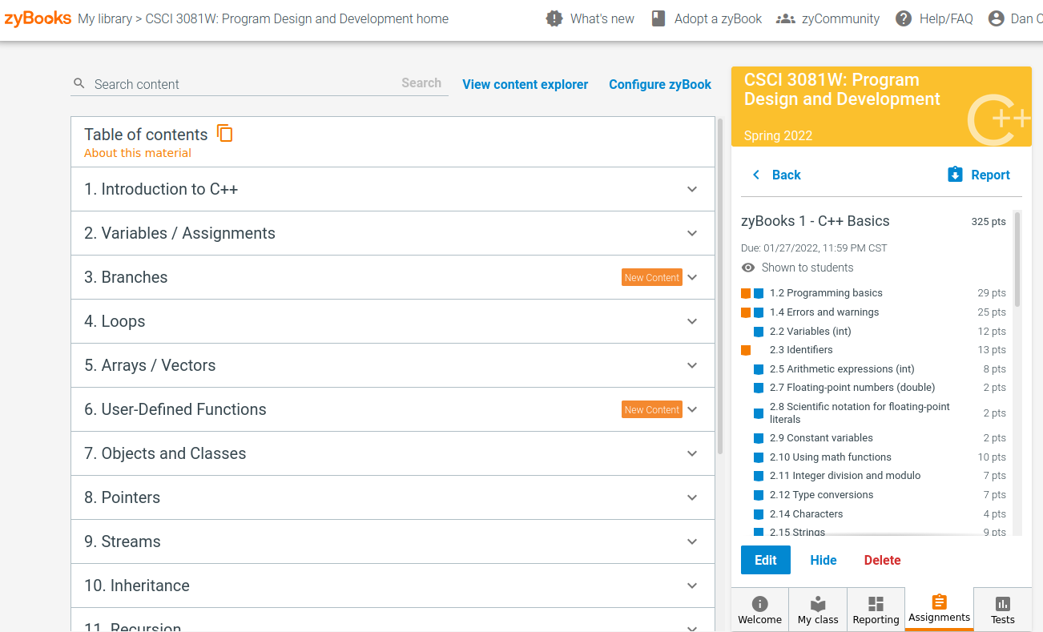
Course Overview
Purpose: Learn C++ Asynchronously
1. Click any zyBooks assignment link in Canvas.
(Do not go to the zyBooks website and create a new account)
2. Subscribe
5%
10%
30%
20%
10%
25%
zyBooks
Workshops
Homework
Final Project
Quizzes
Lab
Allows us to focus more on design and development.

Slide 21
Course Overview
Labs: We will build the transportation system through the labs.
5%
10%
50%
10%
25%
zyBooks
Workshops
Homework
Quizzes
Lab
You will gain hands on experience working with:
TypeScript
Jira
Git
Object Oriented Programming
Memory Management
Design Patterns
Testing
Documentation
More…

Slide 22
Course Overview
Workshops: There will be 6 In-Class coding workshops.
Students will be given a lecture relevant problem to solve by the end of class.
Always graded by participation and correctness.
5%
10%
50%
10%
25%
zyBooks
Workshops
Homework
Quizzes
Lab
You will gain hands on experience working with:
Basic C++
Object Oriented Design
EARS Style Requirements and UML Class Diagrams
Design Patterns
Docker
Agile Process

Slide 23
Course Overview
Homework: There will be 3 homework assignments.
More writing intensive.
Focus on learning objectives beyond project and programming.
Introduce new technologies or paradigms.
5%
10%
50%
10%
25%
zyBooks
Workshops
Homework
Quizzes
Lab
Final Project: Project Proposal and Extension
You will work in a team to develop a new feature for your client in the simulation.
You and your team will “make progress” towards this goal.
You will design, code, document, test, and deploy your new feature.

Slide 24
Course Overview
5%
10%
50%
10%
25%
zyBooks
Workshops
Homework
Quizzes
Lab
Quizzes: There will be 4 take home quizzes (online Gradescope).
These will cover topics from lecture, labs, workshops, and homework.
There is no study guide for these quizzes. Any material covered before a quiz is fair game on a quiz.
You can start the quiz at any time in 24 hours. As of right now, there is no time limit on the quizzes. (subject to change)

Slide 25
Office Hours
Office Hours are held either in person or via Zoom.
Please check the Office Hours Page in Canvas to see the full schedule.
Please be respectful to your TAs!

Slide 26

Late Work Policy
It just doesn’t work in this class:
We usually talk about solutions in the next class.
The labs and project are incremental and students get behind.
Please reach out to me if you have any questions, concerns, or accommodations.
Exceptions to this rule will only be given for university approved accommodations (illness, DRC, etc…)
Even with DRC accommodations, I can’t give extensions if the solution gets released.

Slide 27
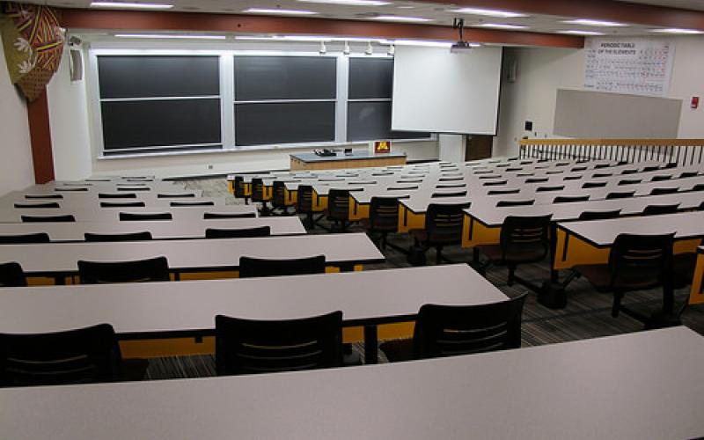
Lecture Modality - Currently In-Person
Lectures will be in person unless anything changes to the University Policy.

Slide 28
Roadmap for Today
Introduction
Course Logistics
Project Discussion

Slide 29
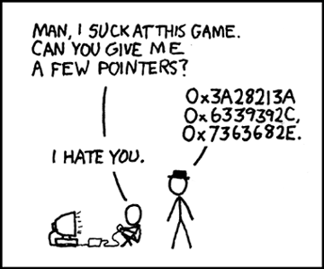


Why C++?
Efficient programming is about managing resources.
Object Oriented practices help us design flexible systems.
C++ is both of these!
 | C | Java | Python | C++
Efficient: Memory Management
Flexible: Object Oriented
“I wish someone would have told me about memory when I first started programming.”

Slide 30


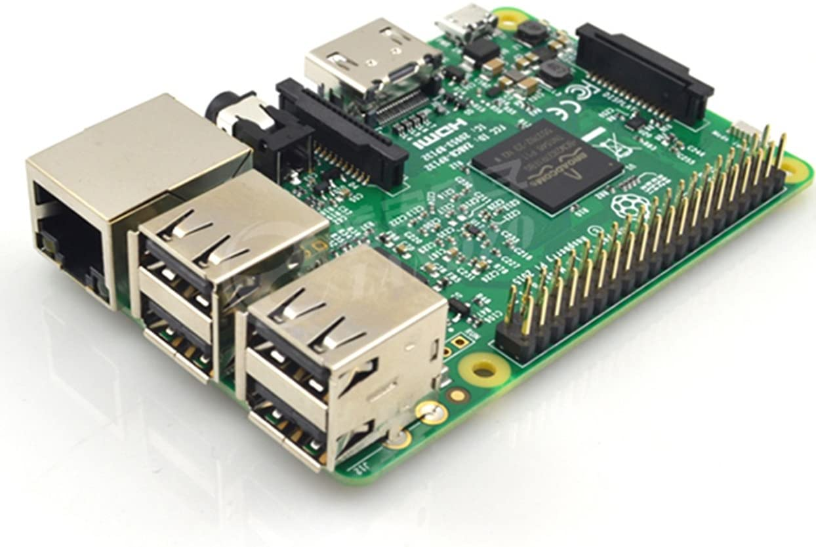

Other really great reasons to use C++.
Computer Graphics
Library Support
System and Device Programming
Standard Template Library

Slide 31
